Slide 1
Thought of the Day
You never appreciate
your blessings
as much as when
they are gone.

Slide 2
Operational Amplifiers
D.C. Kulshreshtha

Slide 3
What is an OP-AMP ?
It is an IC, originally fabricated to perform mathematical operations like summation, subtraction, multiplication, differentiation and integration.
Hence, named as operational amplifier.
It is a direct-coupled, multistage, high input impedance and high gain amplifier.
It has a stabilized gain of the order of 10⁵.
Operating frequency from 0 Hz to about 1 MHz.

Slide 4
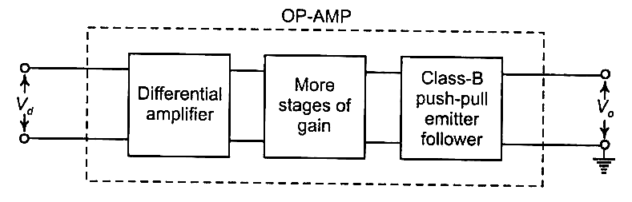
Block Diagram of an OP-AMP

Slide 5
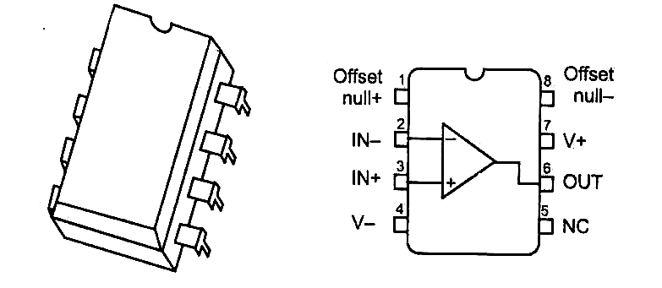
μA 741 (by Fairchild of USA)
Eight pin, Dual-in-line package

Slide 6
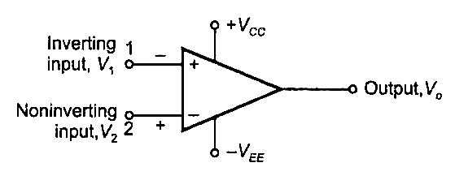
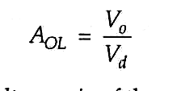
Schematic Symbol of OP-AMP
Open-loop Voltage Gain is

Slide 7
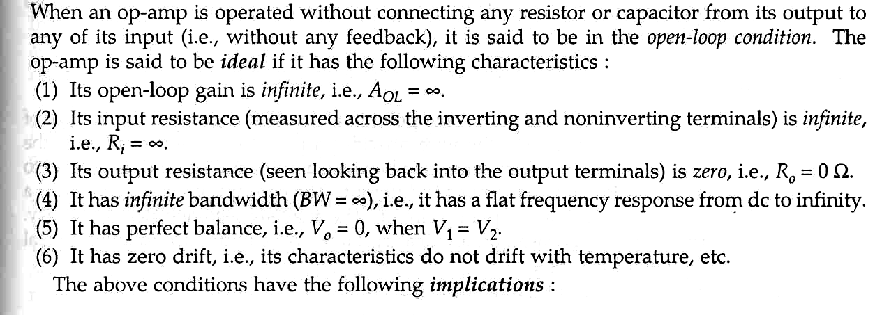
IDEAL OP-AMP

Slide 8
Implications
R_{i} = ∞ means I_{i} = 0. It is voltage- operated device.
R_{o} = 0 means that the output voltage V_{o} is independent of the load. It can drive any n umber of loads.
A_{OL} = ∞ means that for finite V_{o}, V_{d} = 0. That is, the input terminals are virtually shorted.

Slide 9
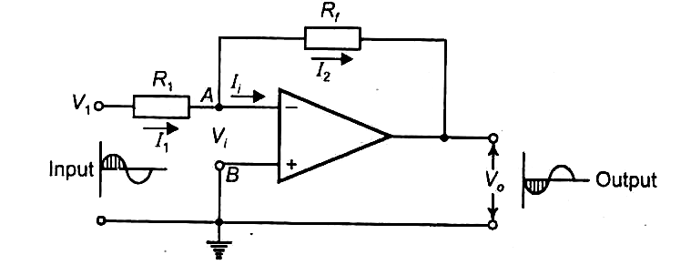
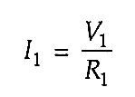

The Inverting Amplifier
Since I_{i} = 0,
I₁ = I₂

Slide 10

Therefore, the closed-loop gain is
The circuit is also called negative scale changer.

Slide 11
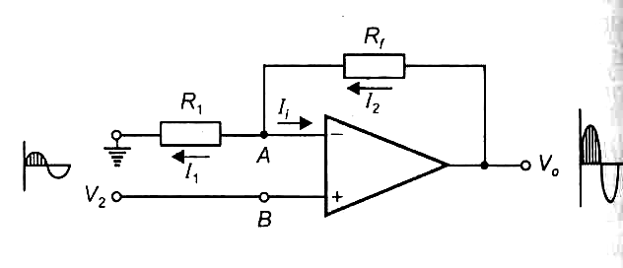
The Noninverting Amplifier
Also called positive scale changer.

Slide 12
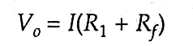

Voltage Gain
Since I_{i} = 0, I₁ = I₂ = I (say).
Due to virtual short at the input terminals, we have V₂ = V_{B} = V_{A} = IR₁.

Slide 13
Simple Applications
Adder or Summing Amplifier
Difference Amplifier.
Subtractor.
Differentiator.
Integrator.
Voltage Follower.

Slide 14
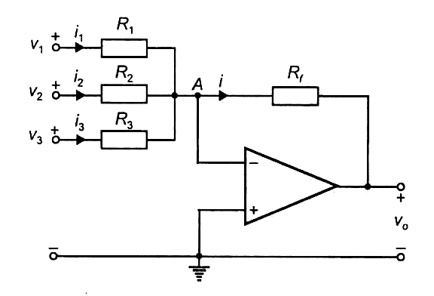
Adder or Summing Amplifier
The point A is virtually grounded.

Slide 15
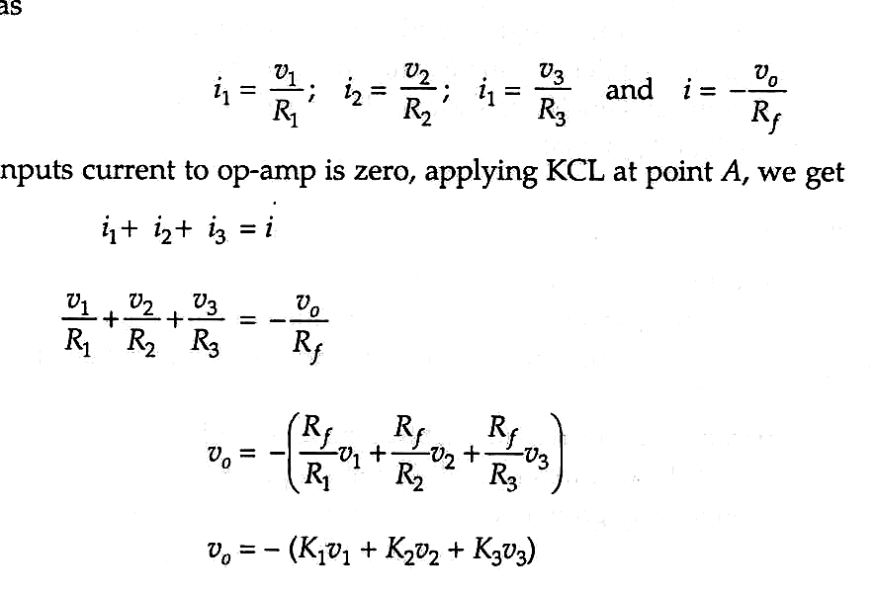

Slide 16
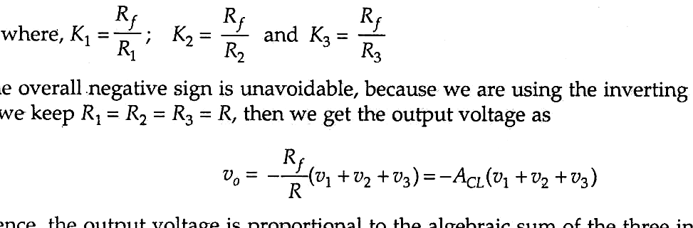

Slide 18
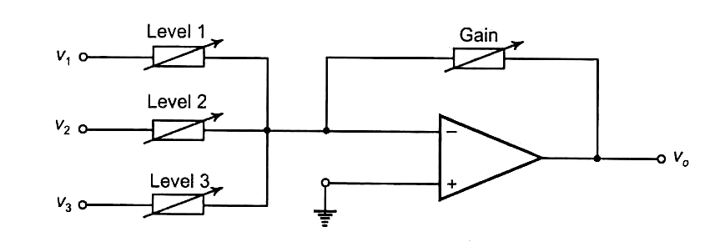
Practical application of Adder
(An Audio Mixer)
Each channel-level or overall gain can be controlled individually .

Slide 19
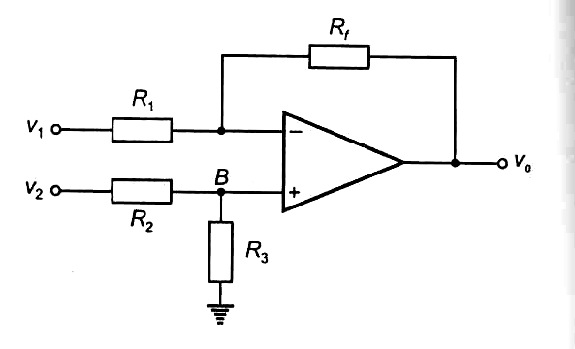
Difference Amplifier

Slide 20
It is a combination of inverting and noninverting amplifiers.
When v₁ = 0, it is a noninverting amplifier.
When v₂ = 0, it is an inverting amplifier.
We shall use superposition theorem to determine output when both the inputs are present.

Slide 21
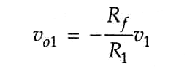
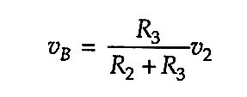
With v₂ = 0, R₁ and R₃ come in parallel, carrying no current. Point B is at ground potential. Thus,
With v₁ = 0, R₁ and R₃ make a potential divider,

Slide 22
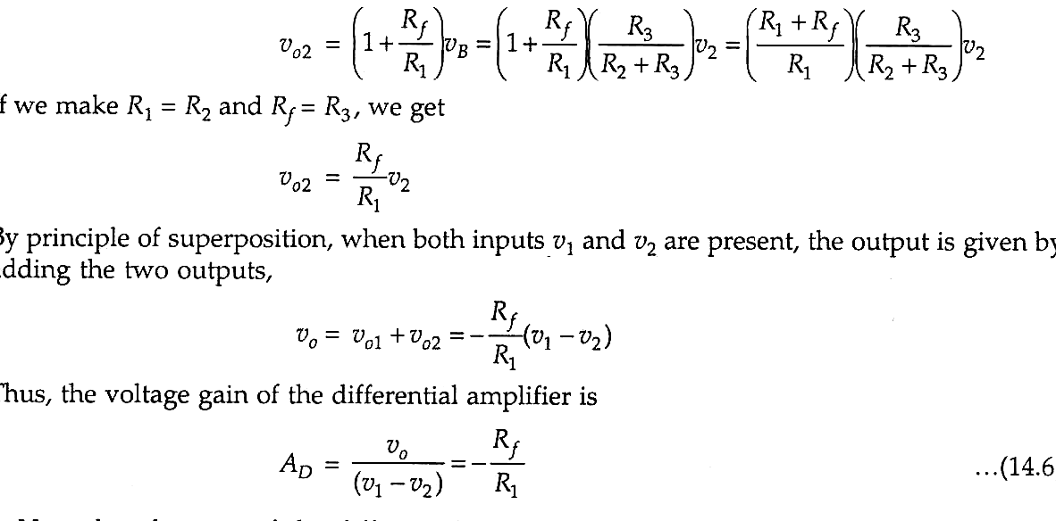
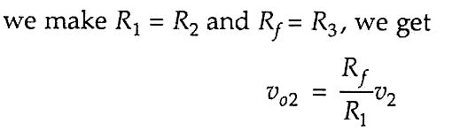


Slide 23
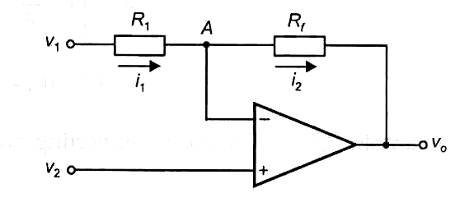
Subtractor

Slide 24
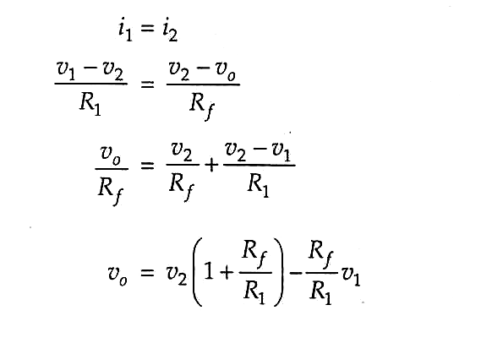
Because of the virtual short, point A is at the same potential as v_{2.}

Slide 25
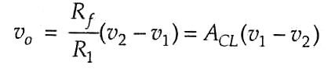
If we make R_{f} » R₁, we get

Slide 26
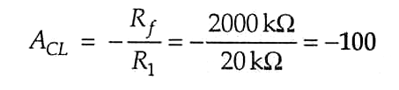
Solution :

Slide 27

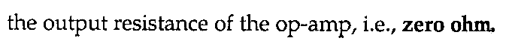

Slide 28
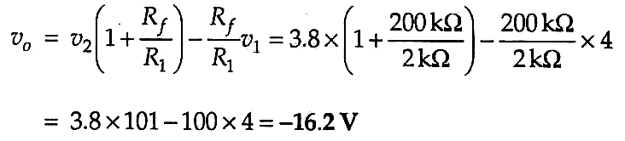

Slide 29
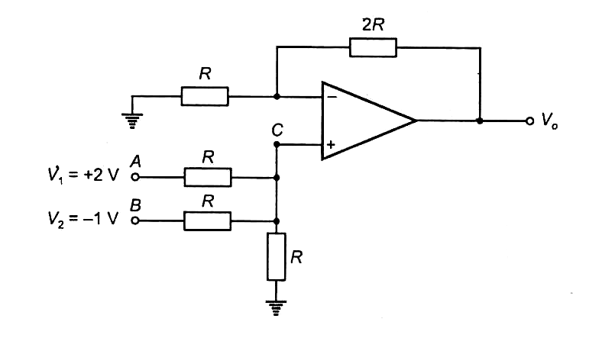

Slide 30
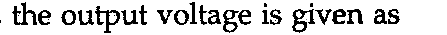






Slide 31
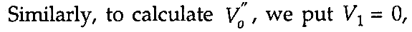
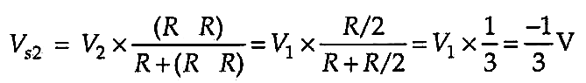

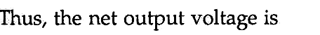
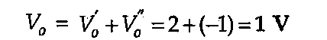

Slide 32
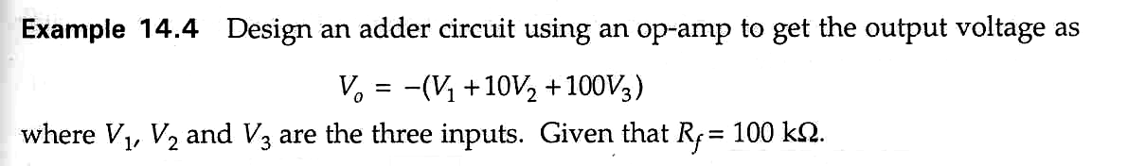
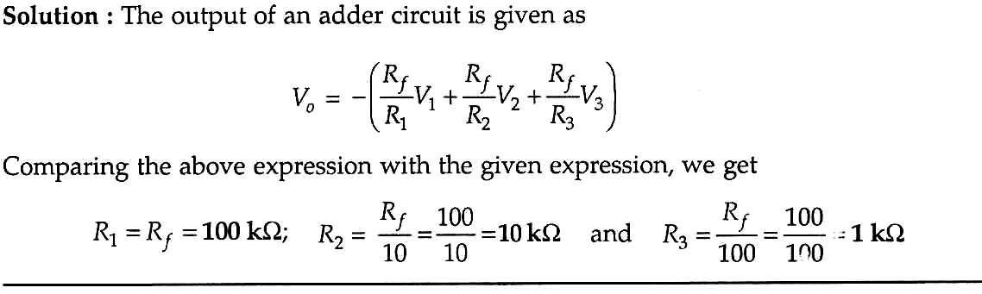


Slide 33
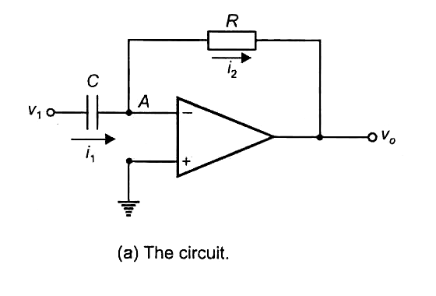
Differentiator
Its output voltage is proportional to the rate of change of the input voltage.

Slide 34
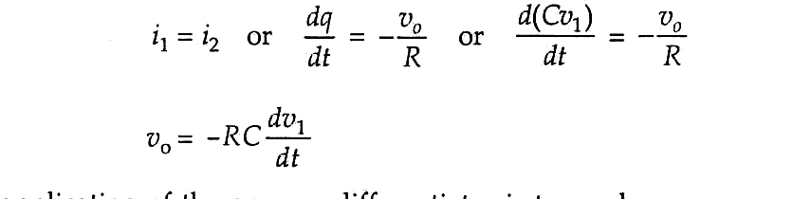

Slide 35
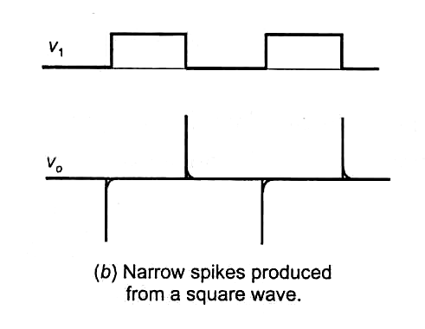

Slide 36
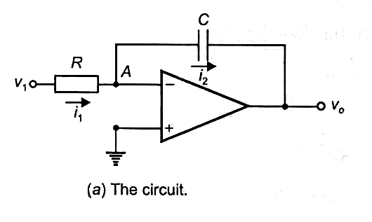
Integrator
Its output voltage is proportional to the integral of the input voltage.

Slide 37
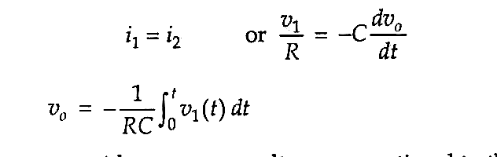

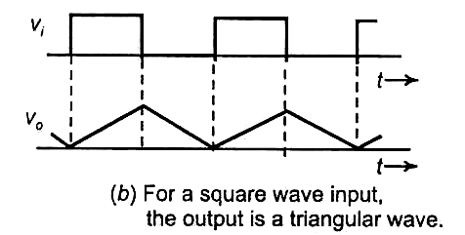

Slide 38
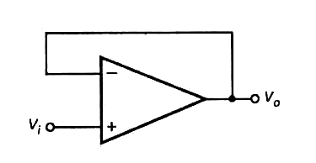
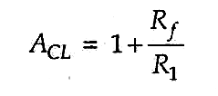
Voltage Follower
The lowest gain possible is 1, for which
R_{f} = 0 (shorting) and R₁ = ∞ (opening)
Used as Buffer Amplifier.

Slide 39
Common-Mode Rejection ratio (CMRR)
An OP-AMP amplifies the differential input signal.
If any signal appears equally at both inputs, the output remains unaffected.
This is the beauty of the OP-AMP. It does not amplify any unwanted signal picked up at the input.
It discriminates against the common-mode signals.

Slide 40

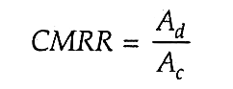
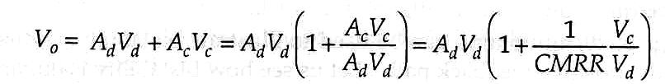
However, in a practical OP-AMP circuit, the output has two components.
Here, A_{d} is the differential gain.
A_{c} is the common-mode gain.
Ideally, we should have A_{c} = 0. We define

Slide 41
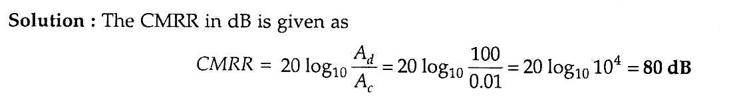
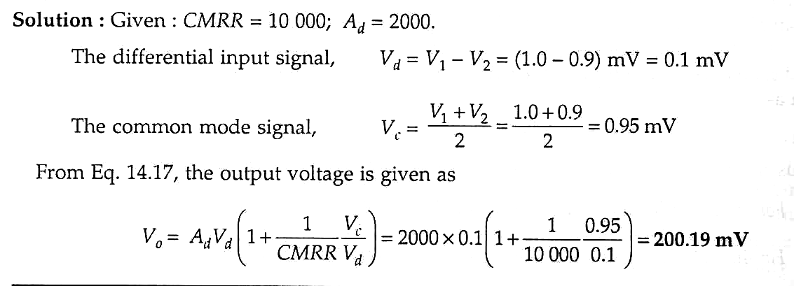

Slide 43
Review
What is an OP-AMP ?
Schematic Symbol of OP-AMP.
IDEAL OP-AMP.
The Inverting Amplifier.
The Noninverting Amplifier.
Adder or Summing Amplifier.
Audio Mixer.
Difference Amplifier.
Subtractor.
Differentiator.
Integrator.
Voltage Follower.
Common-Mode Rejection ratio (CMRR)

